Slide 1
HOS Q1
Which statement is not true? Why is it not true?
GitHub Codespace is created using a dev container hosted on a virtual machine. Therefore, you do not have to set up any dev environment on your local machine.
Since Expo is an open-source platform for making universal native apps for Android, iOS, and the web with JavaScript and React, we do not have to use special IDEs for Android or iPhone.
Since Expo Go is a free, open-source client for testing React Native apps on Android and iOS, we do not have to configure anything on Android or iPhone.
Whenever you change some codes in ”App.js,” Expo will not automatically reload the app in the browser or on the device. So, you have to shut down the Expo server and execute it again.
Notes:
Answer: D Whenever you change some codes in ”App.js,” it will automatically reload the app in the browser or on the device. So, you do not have to shut down the Expo server and execute it again.
A – GitHub Codespaces
B – Expo
C – Expo Go
D- Expo

Slide 2
HOS Q2
Which command is needed to execute your mobile app using expo framework? Assume that you need to test your app on a device connected to a different network than your development machine.
npx expo create-mobile-app my-app
npx expo start --tunnel
npx expo login
npx expo snack
Notes:
Answer: B
expo int to create an Expo React native mobile app
expo start --tunnel to execute your mobile app using expo framework
expo login to login the Expo for Expo Go
expo snack to execute an Expo mobile app in a browser

Slide 3
HOS Q3
Which file is needed for the npm to install dependencies?
.gitignore
App.js
package.json
README.md
Notes:
Answer: C
.gitignore to keep the list of not to be pushed to the GitHub
App.js to keep the top level mobile app source code
package.json to keep the node package dependencies
README.md to mark up documents

Slide 4
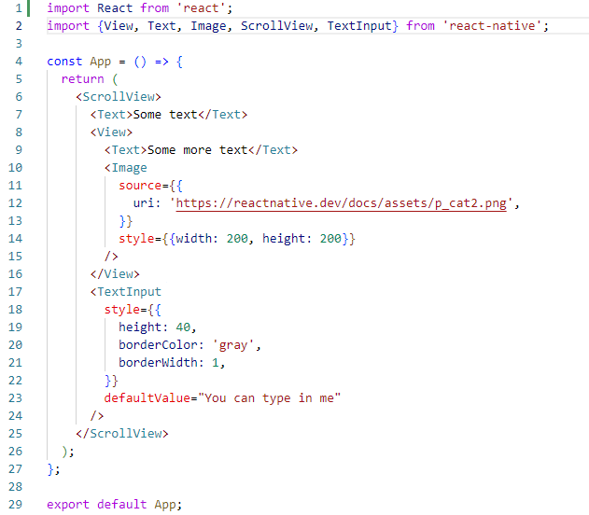
Even if you delete a statement, this program works producing the same output. Which line statement can you delete?
Line 1
Line 2
Line 4
Line 29

